Slide 1
Introduction to KNIME Analytics Platform

Slide 2
Content of this lesson
Download and Install
The Workbench
More on Nodes
Metanodes and Components
KNIME Hub
Build your first „Hello“ Workflow

Slide 3
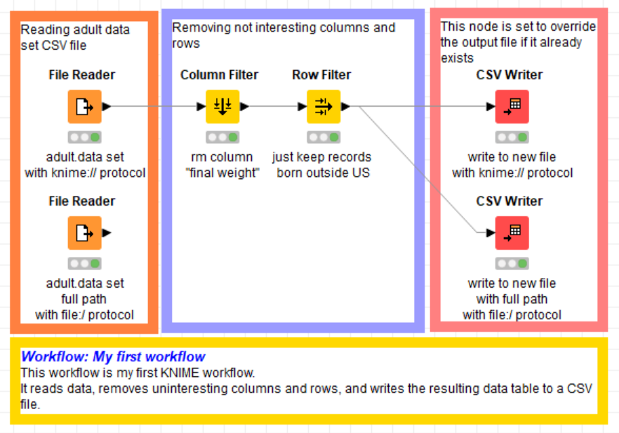
Datasets
Dataset used : adult dataset
Example Workflows:
„My First Workflow“ https://kni.me/w/kYeZOLeAJXo9Mvol
Read from CSV file, Excel file and SQLite.
Filter rows and columns
Write to CSV file

Slide 4
Download and Install

Slide 5

KNIME Analytics Platform
Open and opensource modular Data Science platform
Covers all the data science needs:
Based on the visual programming paradigm
Provides a diverse array of extensions:
Text Mining
Network Mining
Cheminformatics
Deep Learning
Many integrations, such as Java, R, Python, Weka, Keras, Plotly, H2O, etc
... And more
Data Access
Data Preparation
Data Visualization
Machine Learning
Testing
Deployment

Slide 6
KNIME Server
KNIME Server
To integrate the solutions into the IT environment
Scheduling
MLOps
Easy deployment
REST architecture
Auditing tools
Closed source
Yearly license
KNIME Analytics Platform
To develop data science solutions
Structured data
Unstructured data
Machine Learning
Statistics
Open source
Free

Slide 7
Installation
Select the KNIME Analytics Platform version for your computer:
Mac
Windows – 32 or 64 bit
Linux
Download the archive and extract the file, or download the installer package and run it
https://www.knime.com/downloads

Slide 8
The Workbench

Slide 9
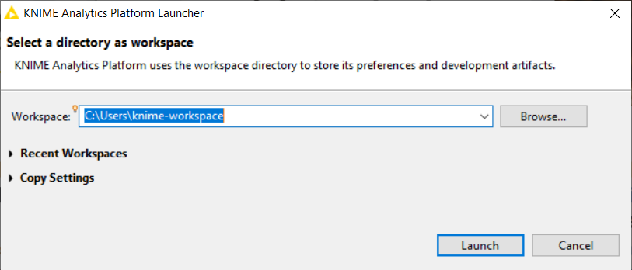
The KNIME Workspace
The workspace is the folder/directory in which workflows (and potentially data files) are stored for the current session.
Workspaces are portable (just like KNIME Analytics Platform)

Slide 10
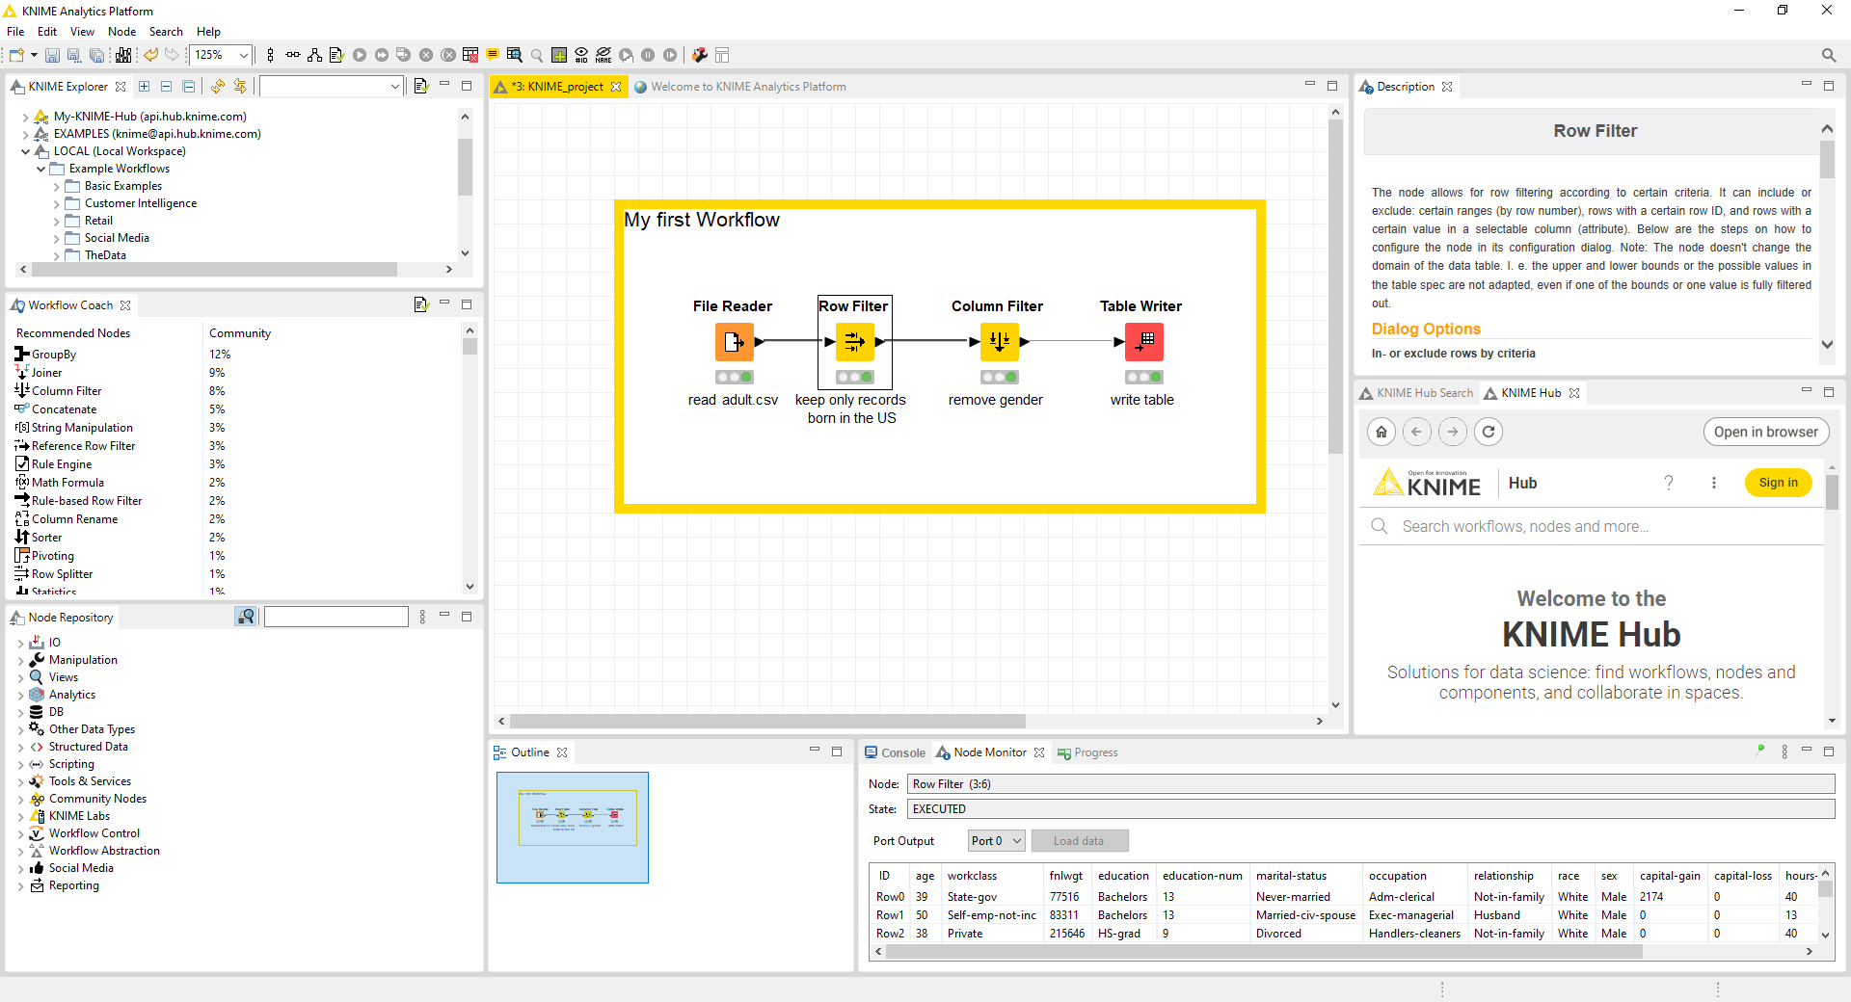

The KNIME Analytics Platform Workbench
KNIME Explorer
Node Description
Workflow Coach
Workflow Editor
KNIME Hub
Node Repository
Console & Node Monitor
Outline

Slide 11
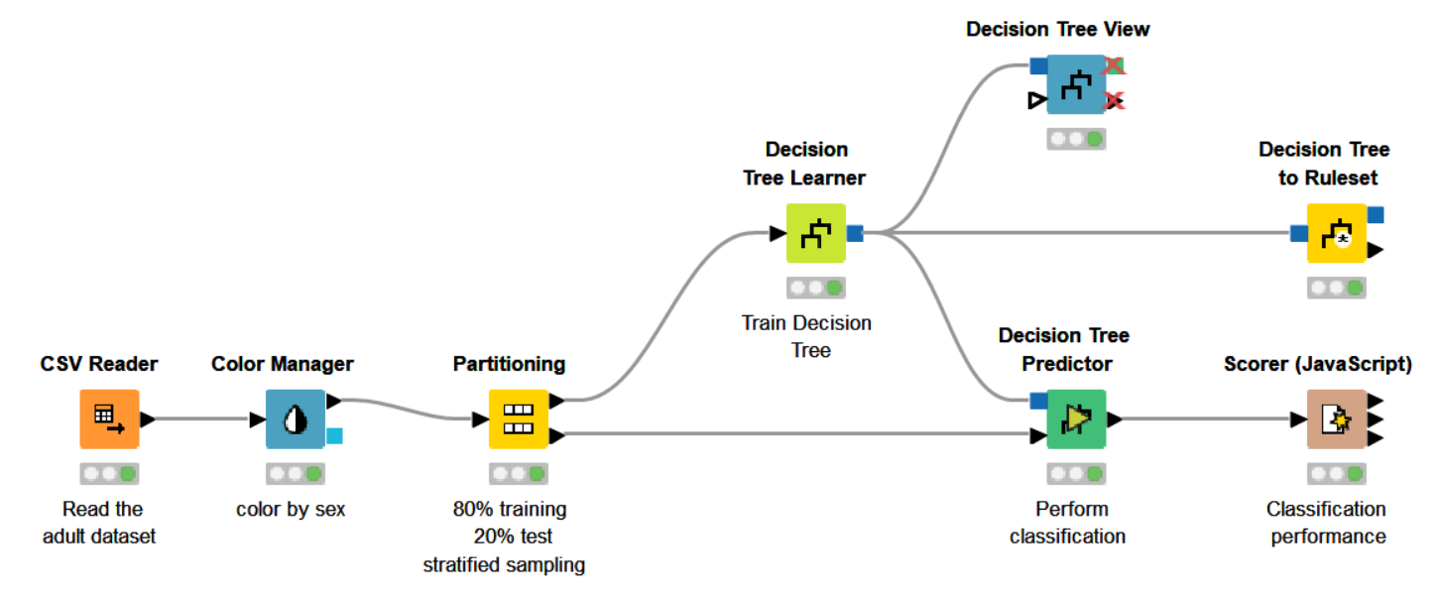
Workflow
A workflow is a pipeline of nodes, each configurable to perform a specific task. The data flow through nodes from left to right

Slide 12
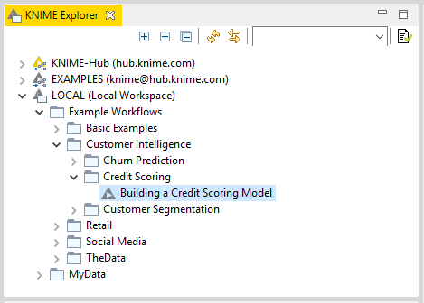


KNIME Explorer
In LOCAL you can access your own workflow projects.
Other mountpoints allow you to connect to
EXAMPLE Server
KNIME Hub
KNIME Server
The Explorer toolbar on the top has a search box and buttons to
select the workflow displayed in the active editor
refresh the view
The KNIME Explorer can contain 4 types of content:
Workflows
Workflow groups
Data files
Shared Components

Slide 13
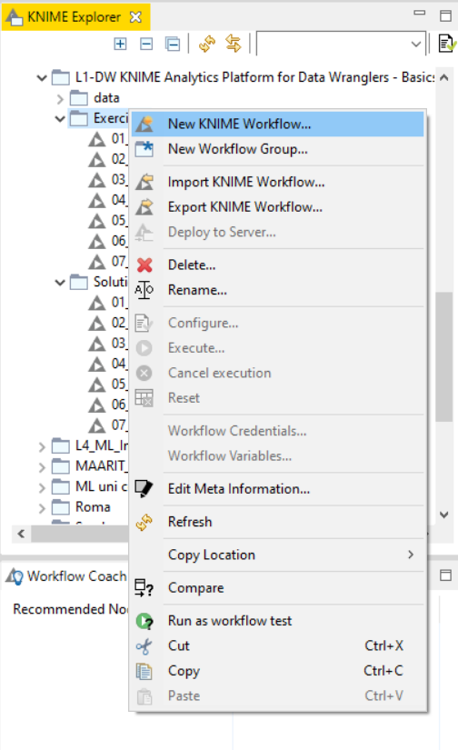
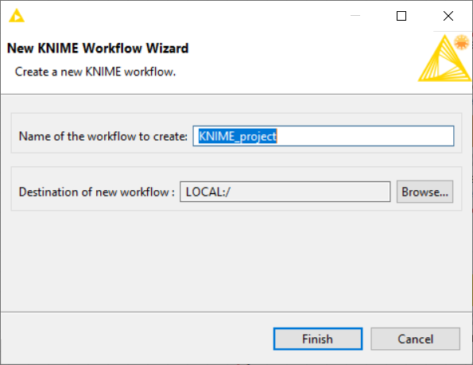
Creating a new workflow
Click anywhere on the KNIME Explorer to create a new workflow or workflow group

Slide 14
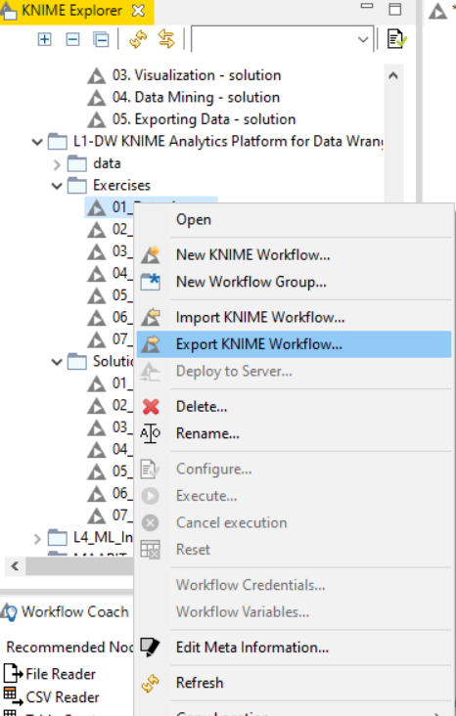
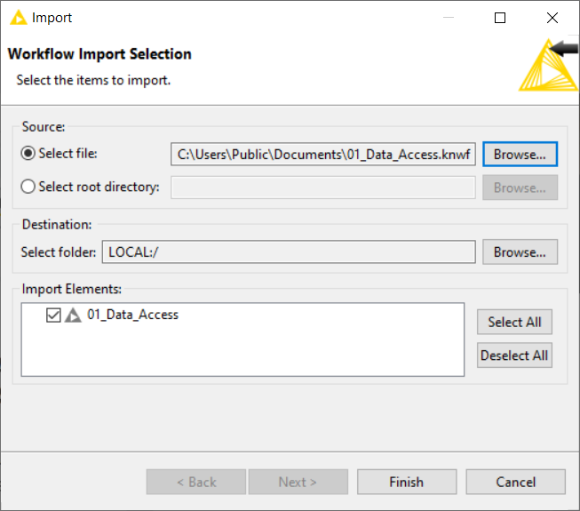
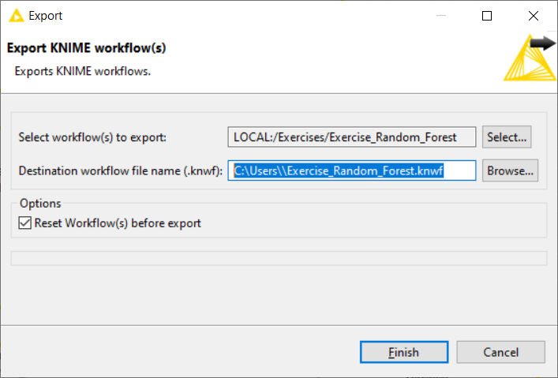
Importing and Exporting Workflows
Right-click anywhere in KNIME Explorer to import a workflow
Right-click on a workflow or workflow group to export the selected workflow

Slide 15


Node Repository
The Node Repository contains all KNIME nodes - ordered by category with further subcategories.
Extension installation can sensibly increase the number of nodes
Two search methods:
Crisp Search
Fuzzy Search
Nodes can be added by drag and drop from the Node Repository to the Workflow Editor

Slide 16
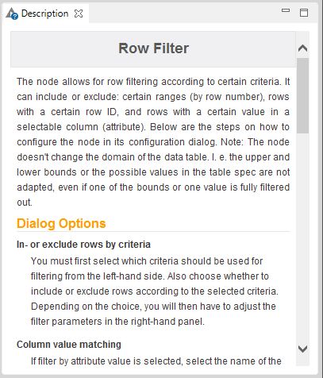
Description
The Description window gives information about:
Node Functionality
Input & Output
Node Settings
Ports
References to literature

Slide 17
Workflow Description
When selecting the workflow, the Description window gives information about the workflow’s:
Title
Description
Associated Tags and Links
Creation Date
Author

Slide 18
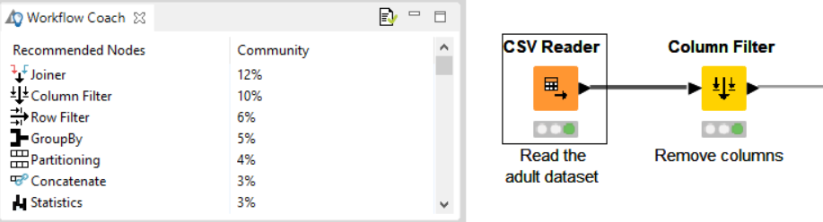
Workflow Coach
Node Recommendation engine
It gives hints about which node to use next in the workflow
It is based on world-wide KNIME community usage statistics
It can also be set to use personal and local group usage statistics

Slide 19
Console and Other views
Console view prints out error and warning messages about what is going on under the hood
Click on View and select Other… to add additional views

Slide 20
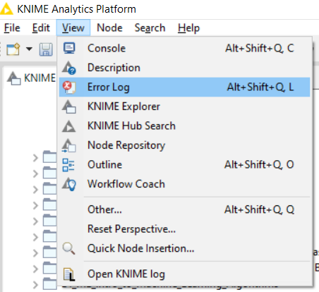
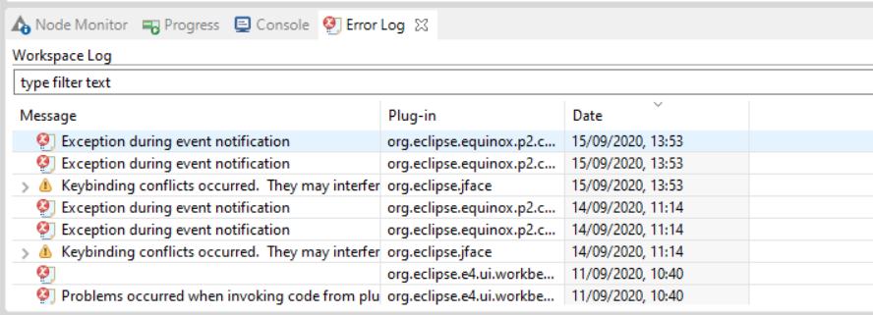
Error Log View
Tip: enabling and checking the Error Log view can help while debugging your project

Slide 21
More on Nodes

Slide 22
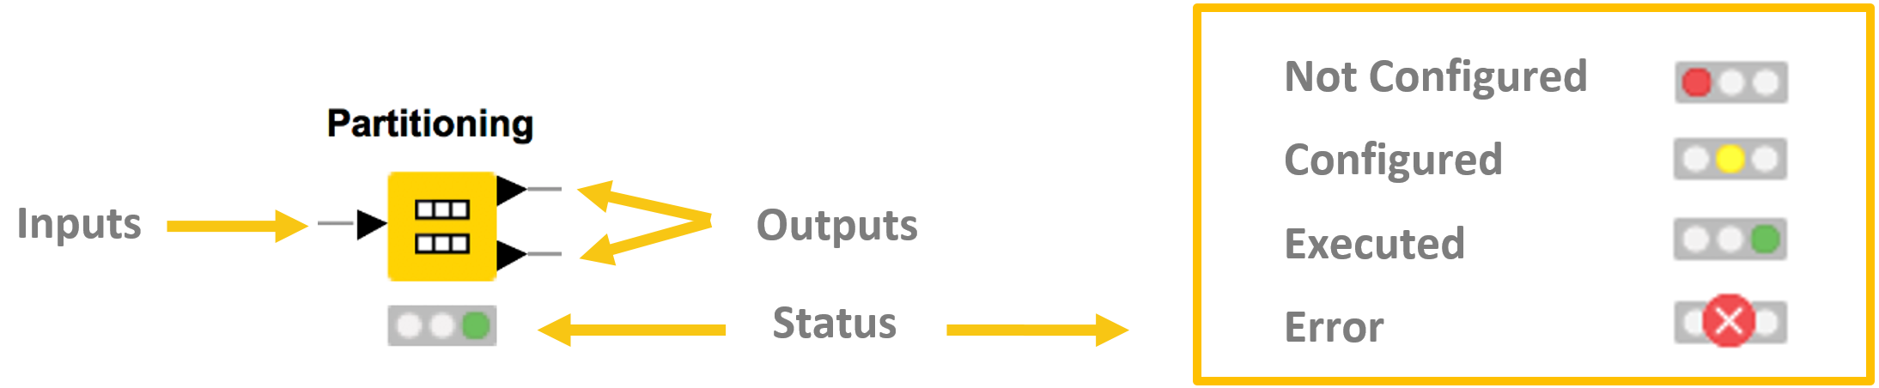
More on Nodes…
Nodes are the basic processing units of a workflow
Each node has a number of input and/or output ports
Data is transferred over a connection from an out-port to the in-port(s) of other nodes
Under each node, a light shows its status

Slide 23
Data Port Types
A pipeline of such nodes makes a workflow
The result of the node’s operation on the data is provided at the out-port to successor nodes
Only port of the same type can be connected
Model
Flow Variable
Image
Data
DB Connection
DB Data

Slide 24
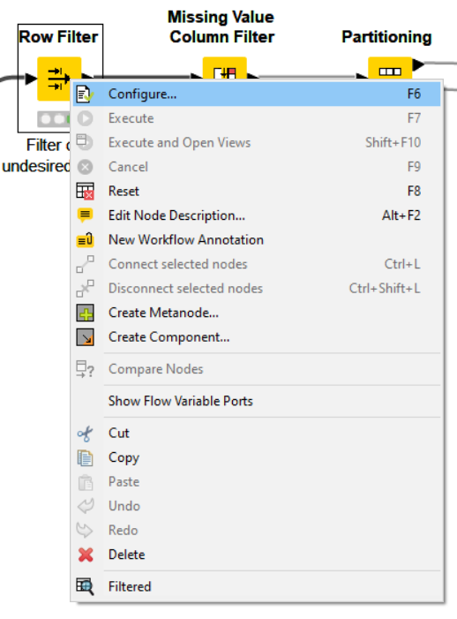
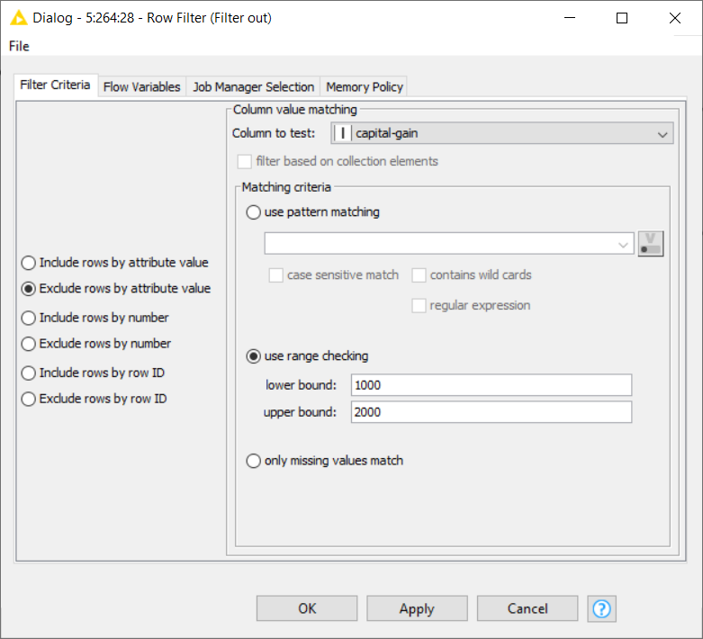
Node Configuration
Most nodes require configuration
To access a node configuration window:
Double-click the node
OR
Right-click > Configure

Slide 25
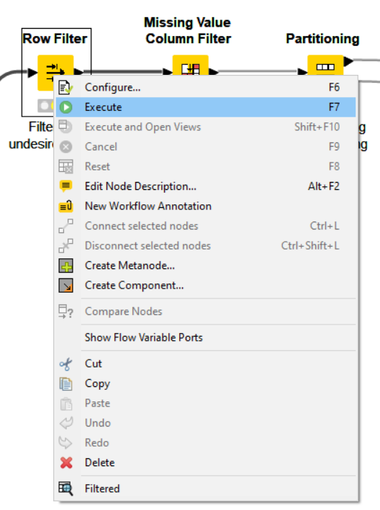
Node Execution
Right-click node
Select Execute in context menu
If execution is successful, status shows green light
If execution produces warnings, status show yellow triangle
If execution encounters errors, status shows a red X

Slide 26
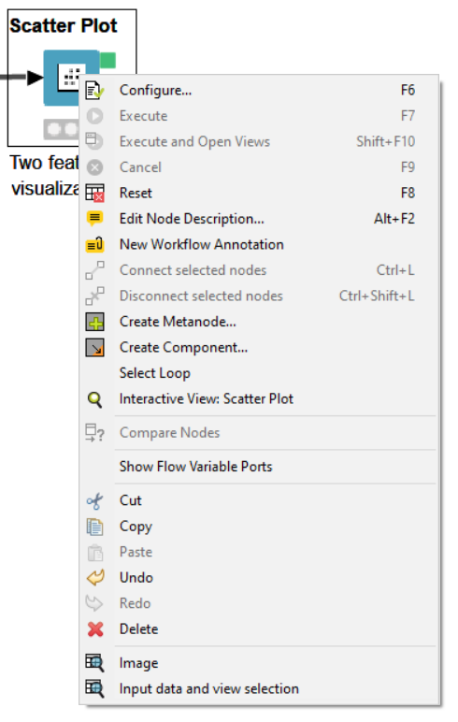
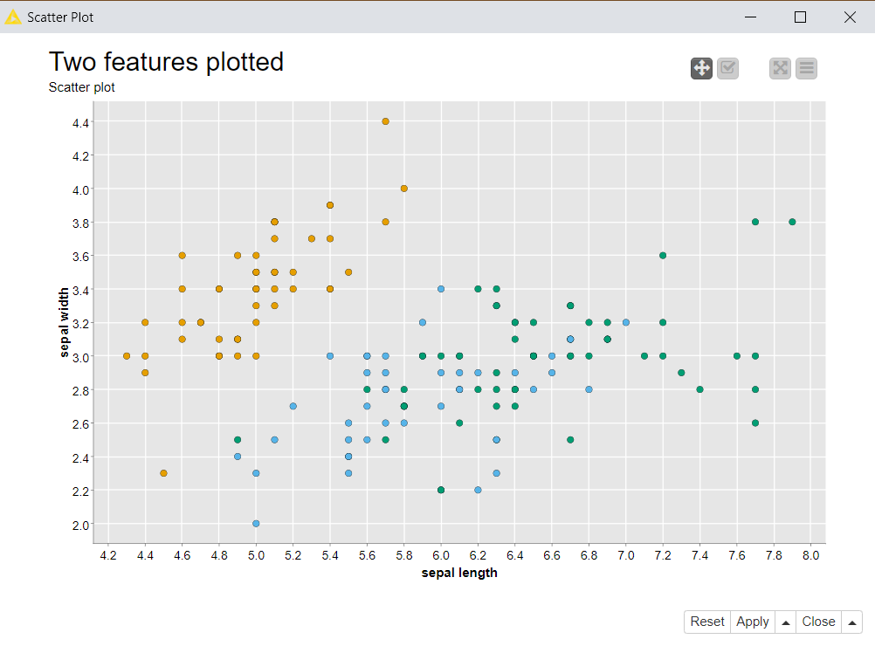
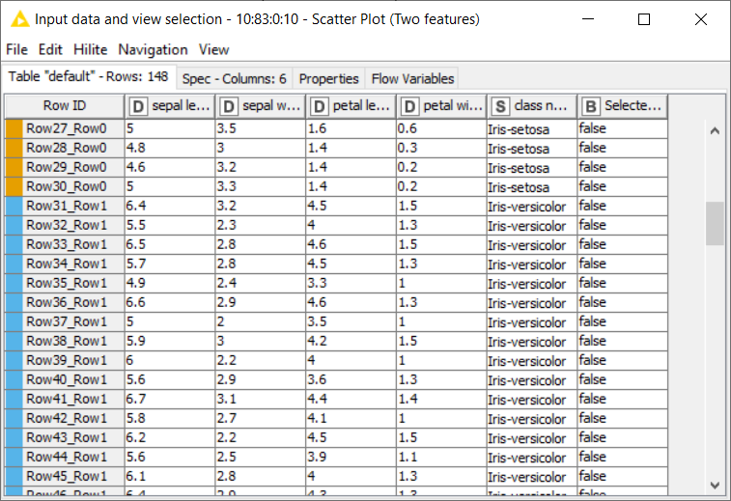
Node Views
Interactive View
Data View

Slide 27
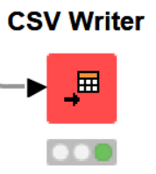
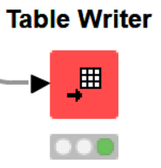
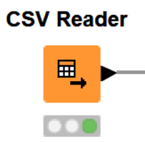
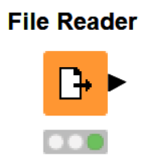
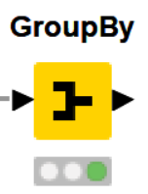
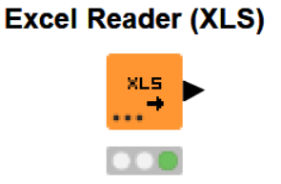
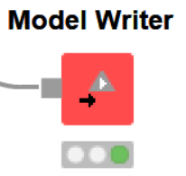
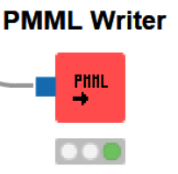
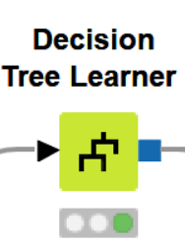
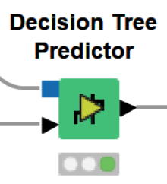
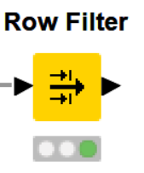
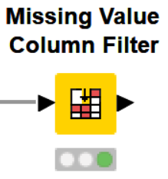
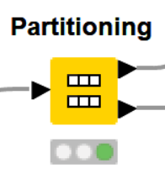
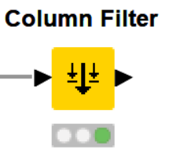
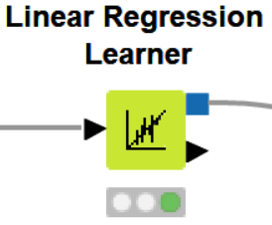
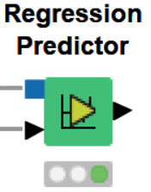
Frequently Used Nodes
Writers
Readers
GroupBy
Learners/Predictors
Filters
Partitioning

Slide 28
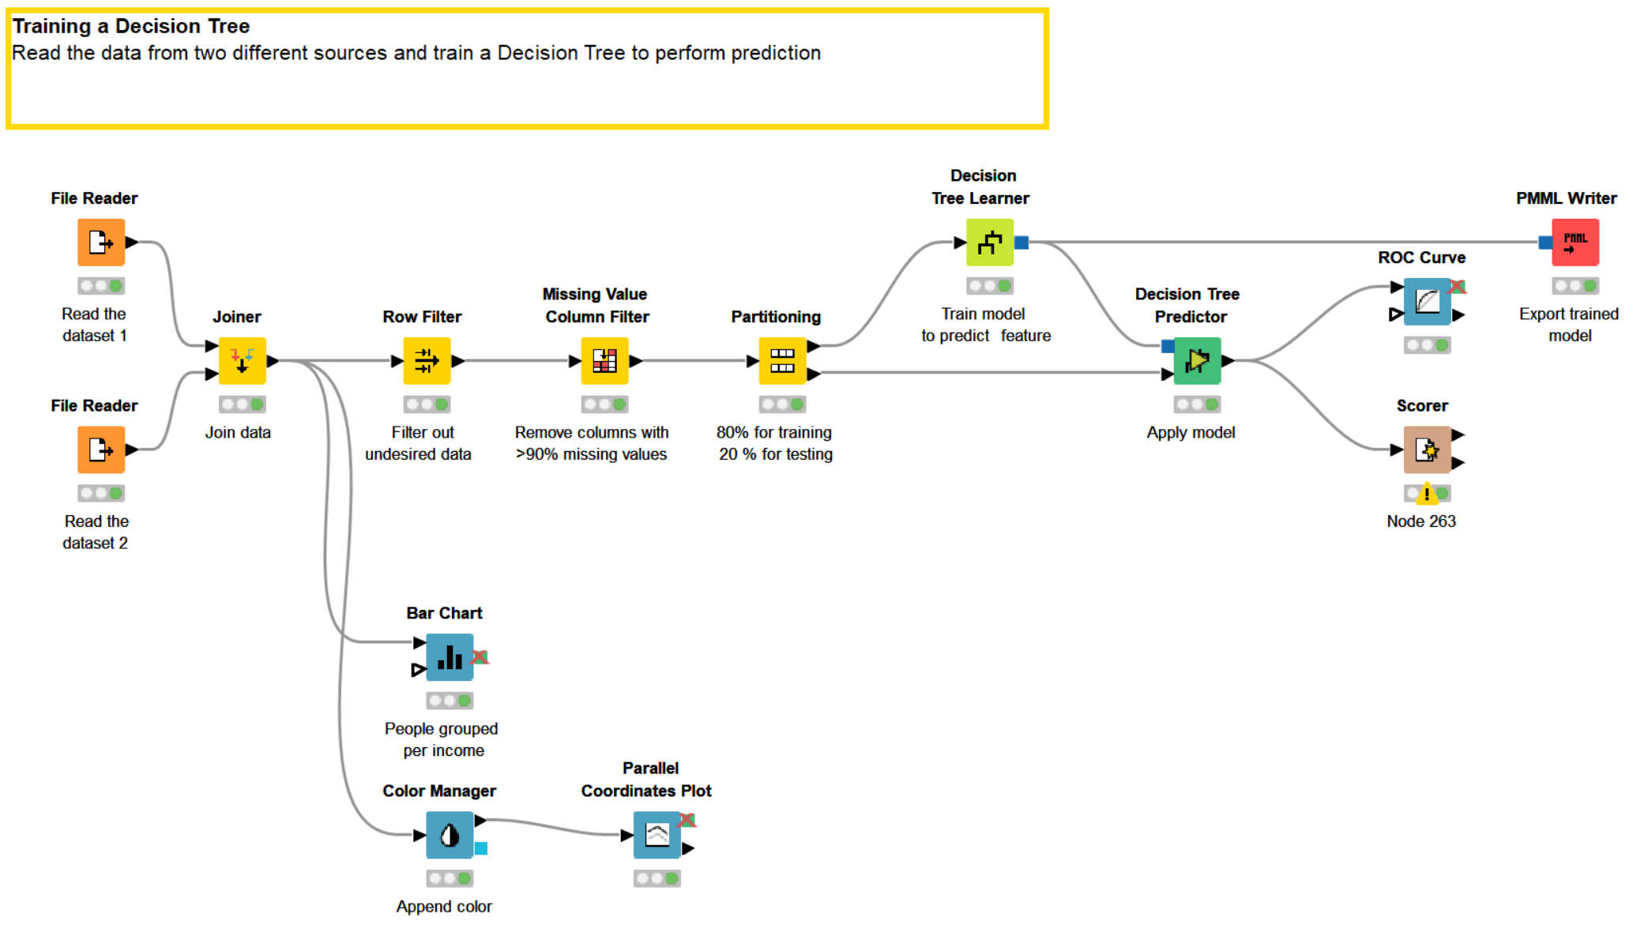
Tidy up workflows
Workflow can easily become complex and difficult to understand

Slide 29
Metanodes and Components

Slide 30
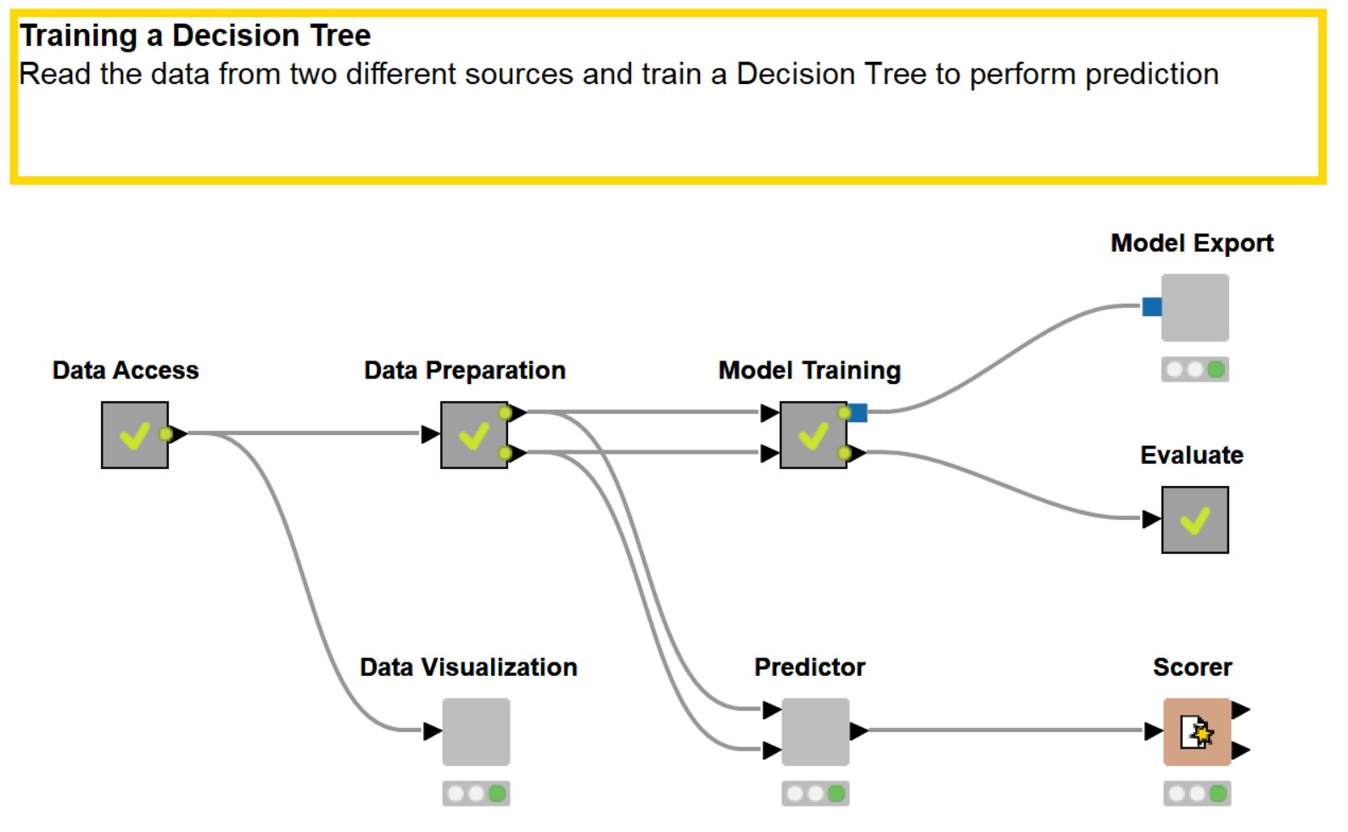
Tidy up workflows
Metanodes and components can help tidying up, encapsulating nodes performing common operations

Slide 31
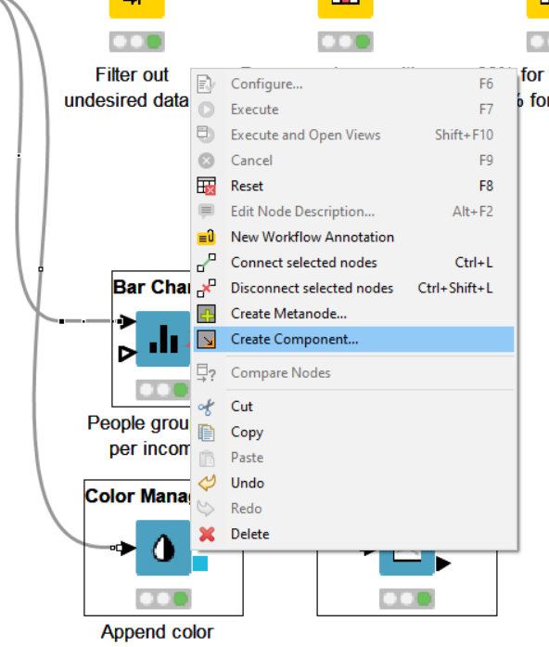
Components
Steps to build a component or a metanode
Select related nodes that you want to group
Right click
Select Create component… or Create Metanode…
Give it a name
Components have more sophisticated features:
Encapsulate flow variables, i.e. the parameters only live inside the component
Provide a configuration window: variables and parameters within the component can be edited by Right Click -> Configure…
Build a composite view: Visualization inside the component can be grouped in a dashboard

Slide 32
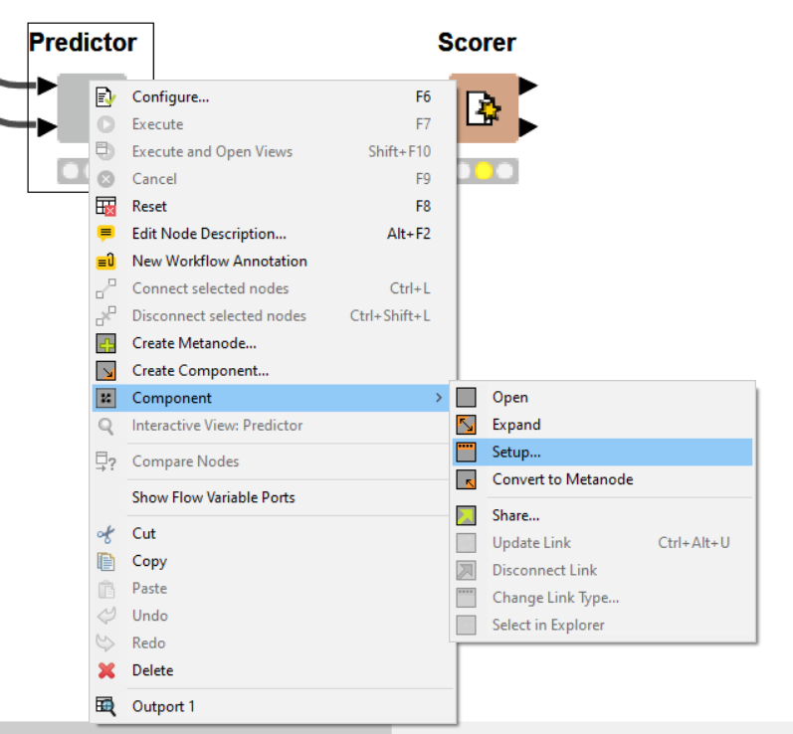
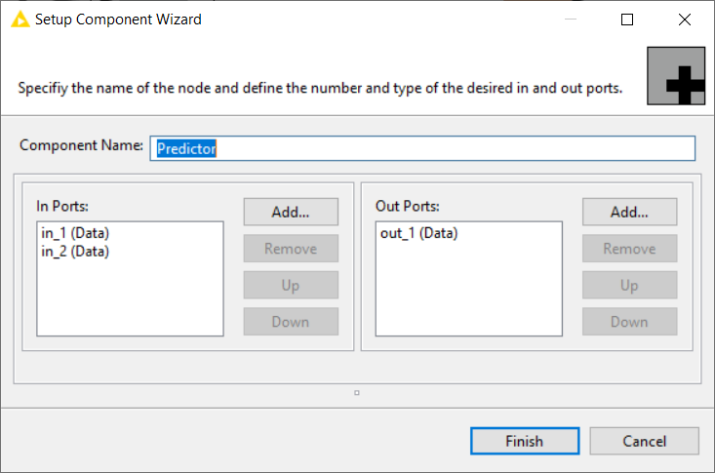
Submenu Component
Right click on the Component and select Setup… from the submenu Component to access further customization settings, such as the component name and the ports

Slide 33
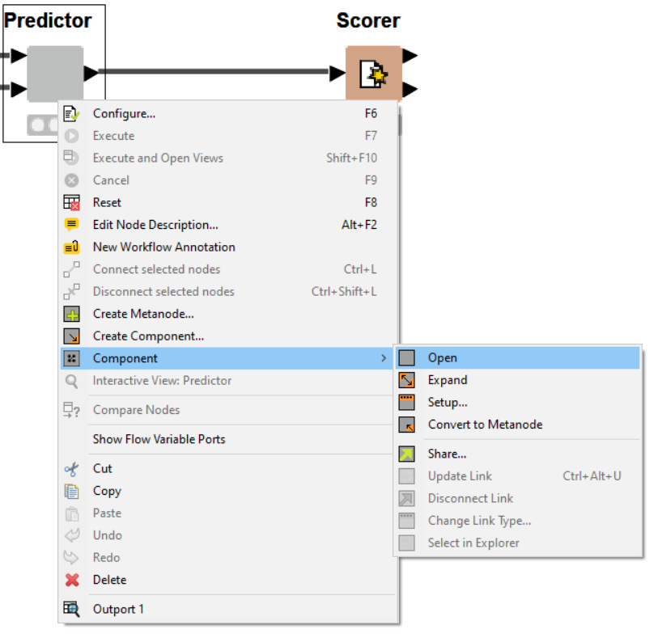
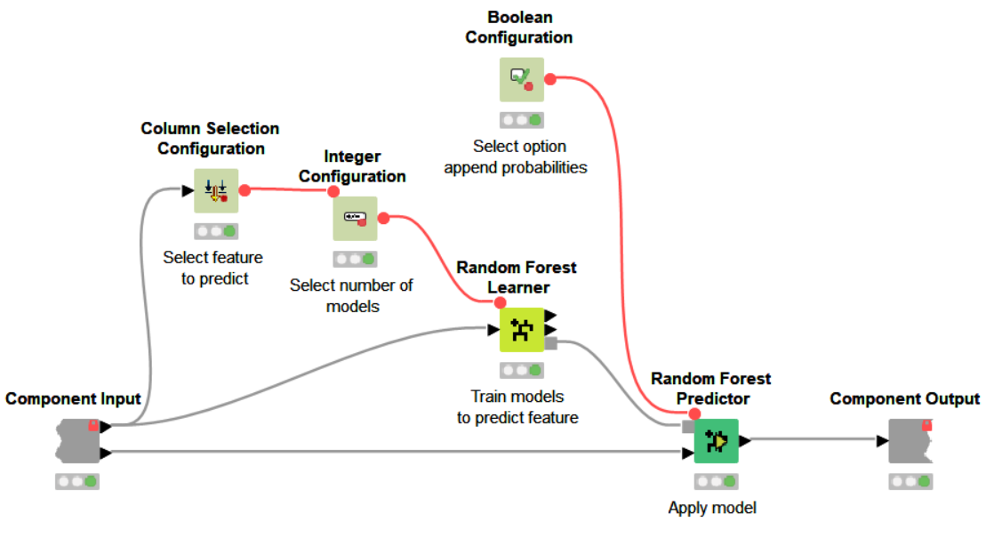
Inside a component
Shortcut:
Ctrl + double click on component to open its content

Slide 34
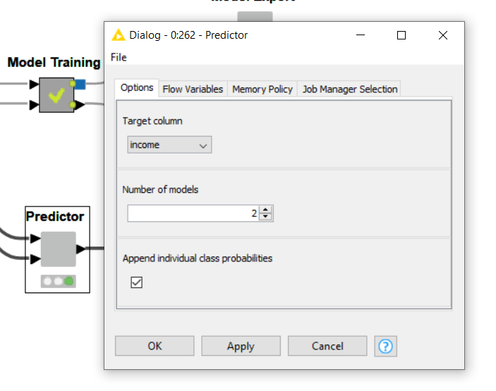
Components Configuration Window
Components can be configurable
From the configuration window (Right click -> Configure…) the user can enter some parameters
The entered parameters change the behaviour of the nodes inside the component

Slide 35
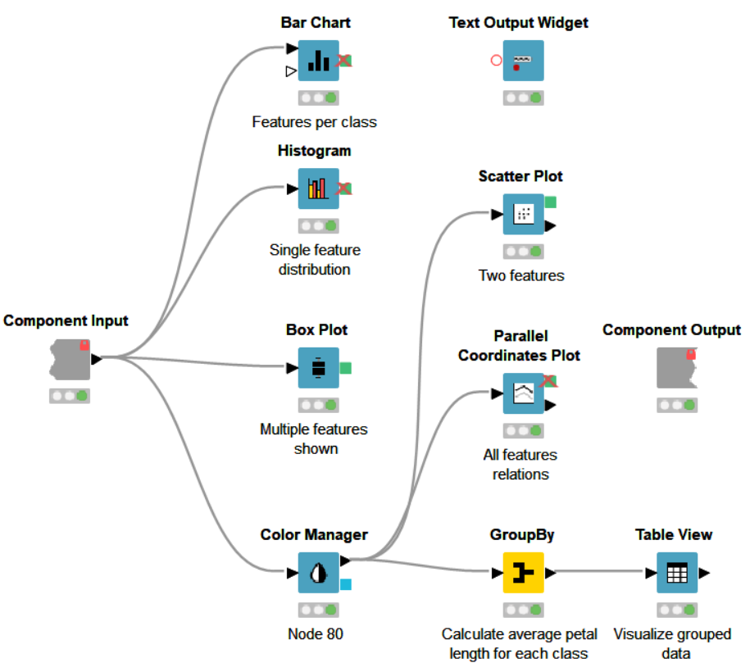
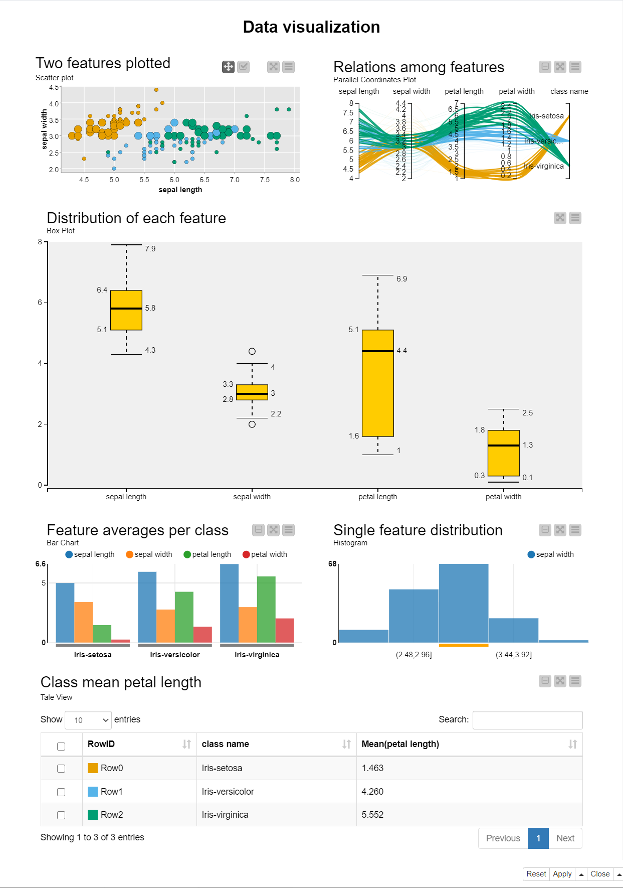
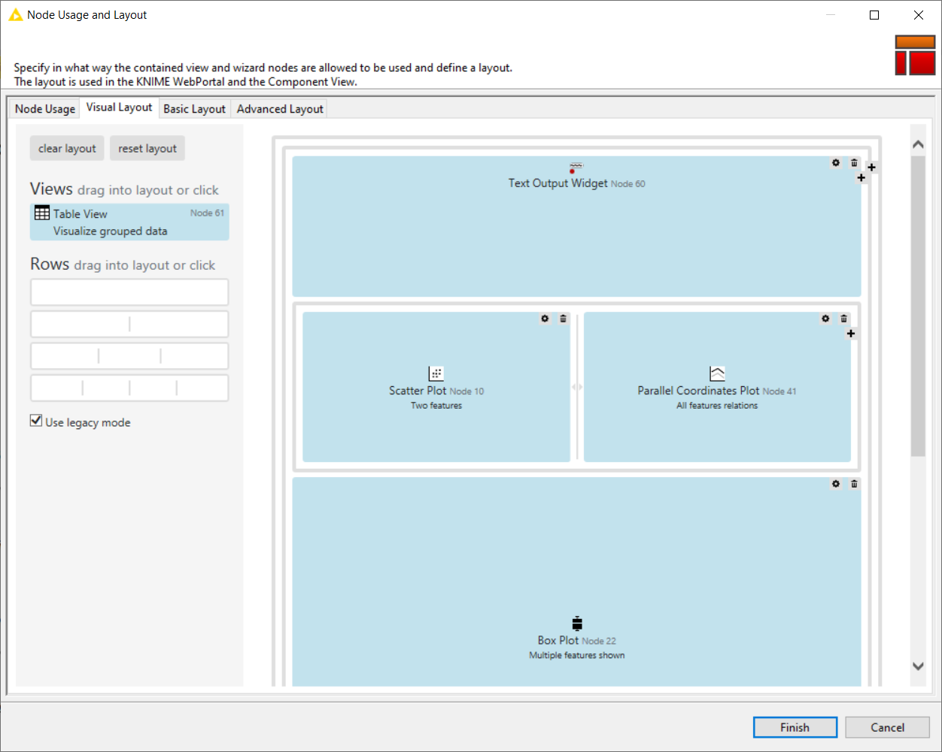

Components Composite View
The visualization nodes within the component can be organized to build an interactive composite view
You can organize and reshape the node views from the Visual Layout window (from inside the component, last icon on the toolbar)

Slide 36
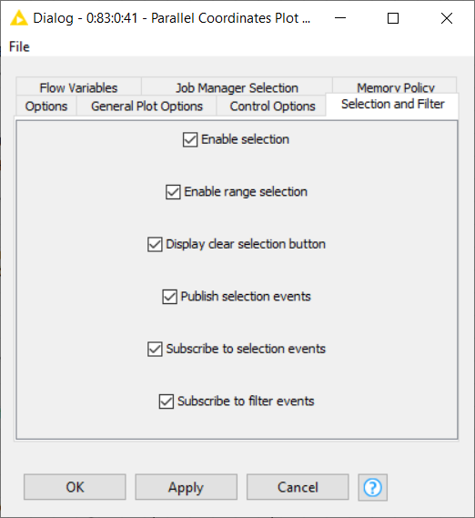
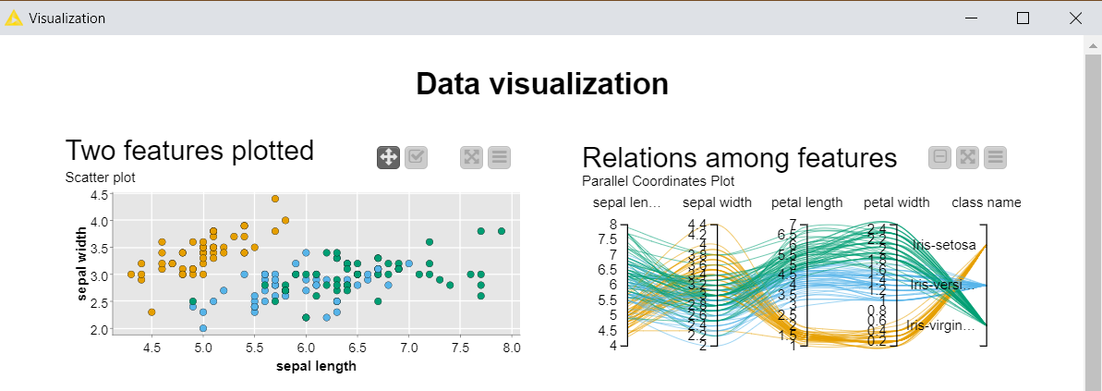

Composite views interactivity
Enable publication and subscription to selection events to make the composite view interactive: data selected in one view are highlighted in the others

Slide 37
KNIME Hub

Slide 38

KNIME Hub
A place to share knowledge about Workflows and Nodes https://hub.knime.com

Slide 39


KNIME Hub
Workflows
Nodes, Shared Components and Extensions

Slide 40

KNIME Hub Spaces
Private Space
Your personal space. Upload here your workflows and components (max 1GB) to have them always available in a central place
Public Space
Shared with the KNIME community. Everyone can find and download them from the KNIME Hub

Slide 41

Downloading and importing from KNIME Hub
Searching for the Tag “theguidebook” will show you all the workflows related to this book

Slide 42


Downloading and importing from KNIME Hub
Method 1
Download the workflow, locate it into your machine and import it as seen before

Slide 43


Downloading and importing from KNIME Hub
Method 2
Drag and drop the icon directly into the KNIME Explorer at the desired location

Slide 44



KNIME Cheat Sheets
https://www.knime.com/cheat-sheets

Slide 45




KNIME Books
e-book downloads from KNIME Press
https://www.knime.com/knimepress
with code: <Promotion-Code>

Slide 46

Free Self-Paced Courses
https://www.knime.com/knime-self-paced-courses

Slide 47
Build your first Hello Workflow

Slide 48


Create your first workflow
Right Click on the LOCAL folder in the KNIME Explorer and select New KNIME Workflow
From the pop up window, insert the name of your first workflow

Slide 49



Read the dataset
Drag and drop the File Reader node from the Node Repository to add it to the workflow
Open the configuration window (double click) and select the file on your machine containing the adult dataset

Slide 50


Remove columns
Some columns have unnecessary information. Remove them with a Column Filter node

Slide 51


Remove Rows
Add a Row Filter node and configure it to only keep entries whose “native-country” value is not “United-States”

Slide 52


Write to new file
Finally add a CSV Writer node to the pipeline.
Configure and execute it to write the transformed dataset to a new file

Slide 53


Annotations
Annotations are coloured editable boxes that you can add to your workflow
They help you making it more readable and visually pleasant
Click on the upper left corner icon to customize text and appearance of an annotation
Right click anywhere on your workflow and add a New Workflow Annotation from the context menu

